Slide 1
Design And Analysis of Algorithms
Department of Information Technology
-----Group Members-----
VIKRAM SINGH ( IIT2019213 )
AKSHAT AGRAWAL ( IIT2019214 )
RAVUTLA RUTHVIK ( IIT2019215 )
ASSIGNMENT-5 DEMONSTRATION
Under the Supervision of: Dr. Rahul Kala
Under the Mentorship of: Md Meraz

Slide 2
INDEX
Introduction and Problem Statement
Divide and Conquer
Approach Used
Algorithm
Conclusion

Slide 3
Problem Statement
Given a set of elements find the average of all elements using Divide and Conquer.

Slide 4
Divide and Conquer
Divide and Conquer is an algorithm design paradigm in which we recursively break down a problem into two or more sub-problems of the same or related type, until these subproblems become simple enough to be solved directly.
This technique has a wide variety of uses. Binary Search and Merge Sort are some such example.

Slide 5
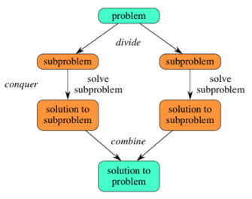
The approach of divide and conquer generally follows 3 important aspects:
1. Divide the problem into a number of subproblems that are smaller instances of the same problem.
2. Conquer the subproblems by solving them recursively. If they are small enough, solve the subproblems as base cases.
3. Combine the solutions to the subproblems into the solution for the original problem.

Slide 6
Approach
The idea is to first find the middle element of the array.
Then we find the average of the elements to the left and right side of the middle element.
Then we combine the two averages to get the final average of the array.

Slide 7
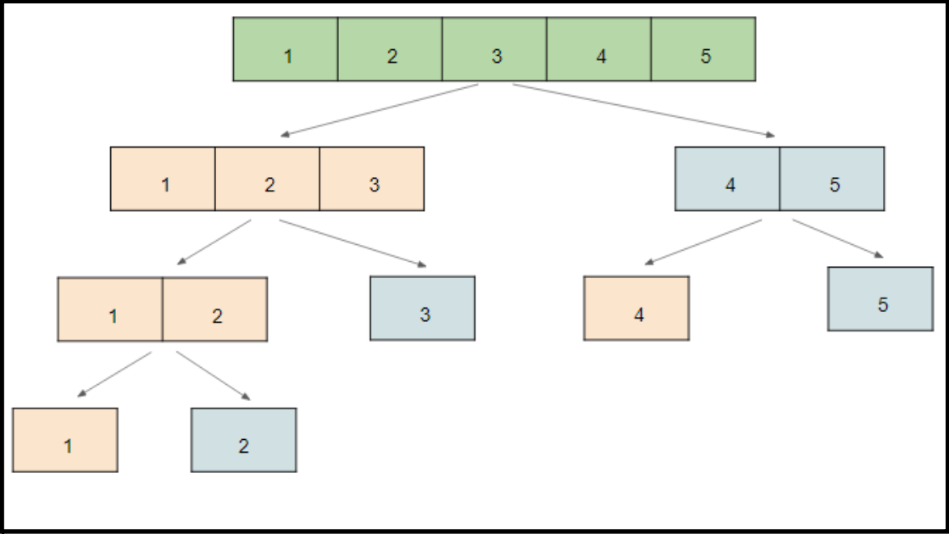
(i) Dividing the input array

Slide 8
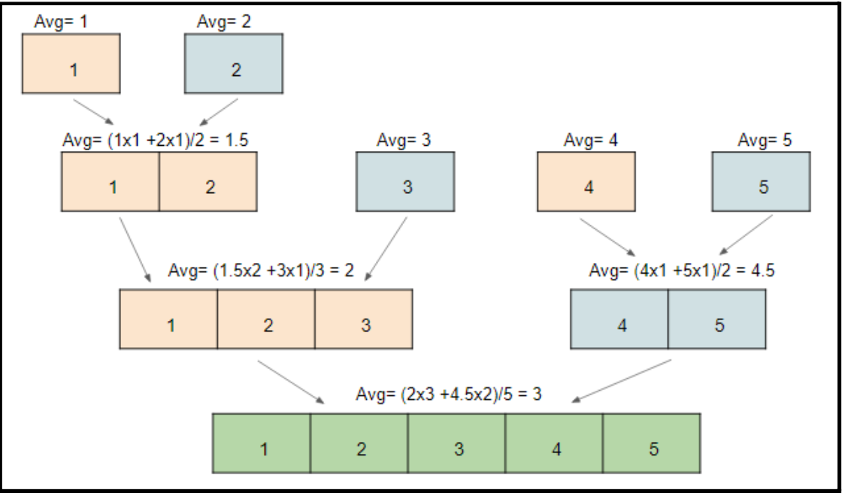
(ii) Combining the smaller subarrays to compute final average

Slide 9
Algorithm
1) First, we find the middle element of the array.
2) Then we calculate the average of the left side of the array by recursively calling the same average function.
3) Repeat the previous step for the right side of the array.
4) Then we combine the two averages according to their lengths to get the final average of the whole array.
5) The formula that we use to calculate the final average is:
((avg of left subarray) x (length of the subarray) + (avg of right subarray) x (length of the subarray)) / (length of the whole array).
6) Using the above formula we can easily calculate the average of the whole array.

Slide 10
PSEUDO CODE
Below is the pseudo code for the find_average function which contains the algorithm described above.
As this function is a recursive function it has the following base conditions which needs to be checked every time the function is called:
● If the value of the left index is greater than the value of right index, return 0.
● If the value of the left index equals the value of right index , return the value of arr[left].
If the value of the left index is greater than the value of right index , then we proceed further according to the above algorithm.

Slide 11
int mid = (left+right)/2;
double lavg=find_average(arr,left,mid);
double ravg=find_average(arr,mid+1,right);
return
(lavg*(mid-left+1)+ravg*(right-mid) )/(right-left+1);
}
double find_average
(double arr[],int left,int right) {
if(left>right) return 0;
if(left==right) return arr[left];
//Base Conditions

Slide 12
ALGORITHM ANALYSIS
Masters Algorithm:
We compare the given recurrence relation with T(n) = aT(n/b) + θ (nklogpn).
Then, we have- a= 2, b= 2, k= 0, p= 0
Now, a = 2 and b⁰= 2⁰ = 1
So, we follow case-01 which is If a > b^{k} , then T(n)
= O(nlogb(a))
So, we have- T(n) = O((nlogb(a)) T(n) = O (nlog2(2)) T(n) = O (n)
The solution of recurrence is O(n) using Master Method.
Time Complexity: O(n)
For the above approach based on divide and conquer, the algorithm can be seen as recurring for 2 arrays of size n/2.
Time Complexity:
Following is recurrence for time complexity
T(n) =2(n/2) + O(1)
The time complexity for such an recurrence relation (T(n) = aT(n/b) + f(n)) can we found out using the

Slide 13
Space Complexity:
Since we input a 1-D array of size N, it will require O(n) space.
Also as the number of variables used in every function call are fixed, if we try to calculate the total number of function calls made (using the method used for calculating time complexity), we get O(n) space complexity.
Thus the overall space complexity of the algorithm is = O(n) + O(n) ≈ O(n).
Space Complexity: O(n)

Slide 14
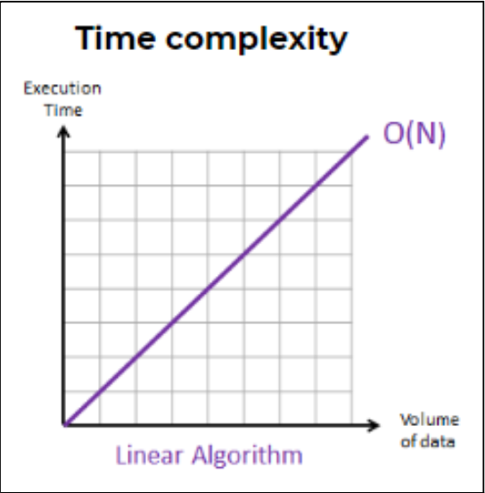
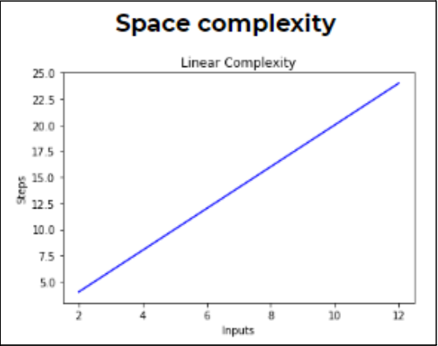
PROFILING
Apriori analysis
The theoretical time complexity that we arrived after the calculations were:
Time Complexity : O(n) Space Complexity : O(n)

Slide 15
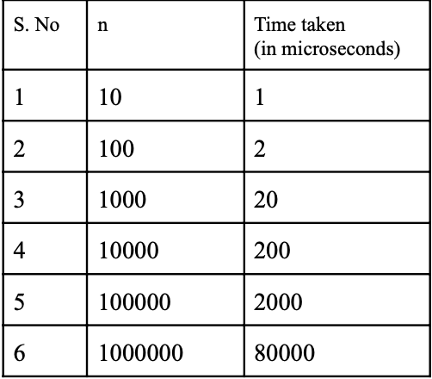
Posteriori analysis
For the Posteriori analysis of the algorithm, we have run our code on the compiler and get values of the time by specifying the value of n and as a result we got different values of the time.

Slide 16
CONCLUSION
We have used a divide and conquer approach with the motive to reduce the time and space complexity of the algorithm. But we find that the time complexity remained the same as found out using the brute force method i.e. O(n). So in this case, the divide and conquer algorithm is not any better than the brute force approach.

